Slide 1
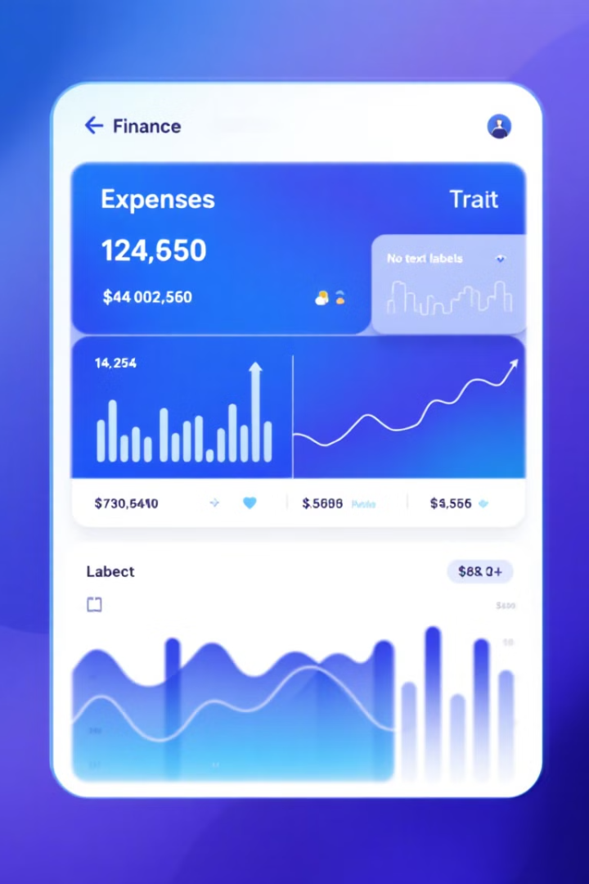
Expense Tracker
Group Name: Code Quad
Group Members:
Satya Datta Jupalli-801362268
Jyotika Koneru-801368572
Narayana Datta Jupalli-801362272
Venkata Chaintanya Mukthineni-801366270
Notes:
Go is a statically-typed, compiled programming language created by Google to address the challenges of modern software development. It is specifically designed for systems and network programming, offering features that make it suitable for building scalable and efficient applications. Go focuses on simplicity, with an easy-to-read syntax, fast compilation, and built-in concurrency support. These qualities allow developers to build robust software quickly, making it ideal for projects requiring performance, scalability, and maintainability.

Slide 2
The Go Language Paradigm
Paradigm
Design Goals
Go is a statically-typed, compiled, and concurrent programming language developed by Google. It is primarily designed for systems programming, network programming, and building scalable and efficient software applications.
The key design goals of Go include simplicity, efficiency, and productivity. Go aims to provide a straightforward syntax, fast compilation, and built-in support for concurrency and parallelism, making it well-suited for modern software development challenges.
Notes:
Go’s creation reflects the evolution of programming languages over decades. In the 1970s and 1980s, languages like C and Pascal emphasized efficiency and control. By the 1990s, Java and C++ brought object-oriented programming, but their complexity led to challenges for developers. To address these, Go was created between 2007 and 2009 by Google engineers Robert Griesemer, Rob Pike, and Ken Thompson. Go combines the simplicity of earlier languages with modern features like concurrency, making it an optimal choice for today’s fast-paced software development.

Slide 3
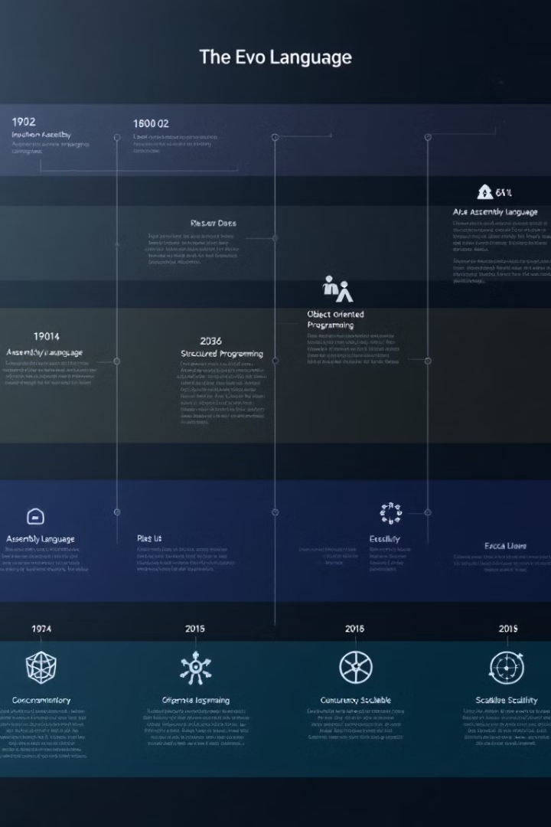
Go in the Evolution of Programming Languages
1
1970s-1980s
The origins of Go can be traced back to the early days of systems programming, with languages like C and Pascal laying the foundation for the development of low-level, efficient programming tools.
2
1990s-2000s
The rise of object-oriented programming (OOP) and languages like Java and C++ introduced more complex syntax and abstraction, which led to the need for a simpler, more concise language for systems programming.
3
2007-2009
Go was created by a team of engineers at Google, including Robert Griesemer, Rob Pike, and Ken Thompson, as a response to the growing complexity and challenges of modern software development.
Notes:
Go stands out due to its simplicity, speed, concurrency support, and robust tooling. Its minimalist syntax avoids unnecessary complexity, making code more readable and maintainable. Go’s built-in support for concurrency, through goroutines and channels, enables scalable multitasking. The language’s rapid compilation process accelerates development, and its built-in tools, such as go fmt for formatting and go test for testing, streamline workflows. These features make Go a practical and efficient choice for developers building modern software.

Slide 4
What Makes Go Unique?
Simplicity
Concurrency
Go's syntax is deliberately simple and concise, with a focus on readability and maintainability. It omits many features found in other languages, such as inheritance and generics, in favor of a more straightforward approach.
Go was designed with built-in support for concurrency, making it easier to write scalable and high-performance applications. Its lightweight "goroutines" and channels provide a powerful and efficient way to handle concurrent tasks.
Compilation Speed
Tooling
Go's compilation process is remarkably fast, allowing for rapid development cycles and improved productivity. This is achieved through a combination of language design choices and the use of a custom compiler toolchain.
Go comes with a robust set of built-in tools, such as the go fmt command for formatting code, the go test command for running tests, and the go build command for compiling applications, which enhance the developer experience and streamline the development workflow.
Notes:
Go offers multiple advantages for software development. Its fast runtime and compilation speed make it suitable for high-performance, low-latency applications. The clean and simple syntax ensures that developers can write readable and maintainable code, facilitating teamwork and collaboration. Go’s concurrency features allow applications to efficiently handle multiple tasks, making it ideal for scalable projects. Its comprehensive suite of tools promotes consistency and simplifies tasks like formatting, building, and testing, significantly boosting productivity.

Slide 5





The Benefits of Using Go
Speed
Simplicity
Go's compilation speed and efficient runtime make it well-suited for building high-performance applications that require low latency and responsiveness.
The language's straightforward syntax and minimalist design enable developers to write clean, readable, and maintainable code, improving productivity and collaboration.
Concurrency
Tooling
Go's built-in support for concurrency and parallelism allows developers to write scalable applications that can take advantage of modern hardware and efficiently handle multiple tasks simultaneously.
The comprehensive set of Go tools and utilities, such as the go fmt and go test commands, streamline the development workflow and promote consistency across a codebase.
Notes:
Go is designed for clarity and efficiency with key structural elements that enhance development. Code is organized into packages, allowing for modular design and easier code reuse. Functions in Go have a concise syntax and support multiple return values, adding flexibility to development. Go’s structs enable the creation of custom data types, facilitating object-oriented programming without unnecessary complexity. These features ensure that Go is both easy to learn and powerful enough to handle complex tasks.

Slide 6


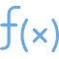

Key Syntax and Structural Elements
Packages
Go organizes code into packages, which are similar to modules or libraries in other languages.
Functions
Go has a clean and concise function syntax, with support for multiple return values.
Structs
Go's struct type allows for the creation of custom data structures and object-oriented programming.
Notes:
Go’s syntax and structural elements are designed to prioritize simplicity and efficiency. Code organization revolves around packages, which serve as modular units similar to libraries, allowing developers to structure and reuse their code easily. Functions in Go are concise and powerful, offering features like multiple return values, which enhance flexibility in application design. Another standout feature is Go’s structs, which enable the creation of custom data types to define objects and encapsulate related data. These core elements make Go straightforward yet powerful, equipping developers to build clean, maintainable, and scalable applications efficiently.

Slide 7
Go for the Win
1
Scalability
2
Concurrency
3
Performance
4
Simplicity
5
Productivity
In conclusion, the Go programming language offers a compelling combination of features that make it a powerful choice for a wide range of applications, from systems programming to network services and beyond. By prioritizing simplicity, efficiency, and concurrency, Go empowers developers to build scalable, high-performance software that is both easy to write and maintain.
Notes:
Go offers significant advantages that make it a leading choice for modern programming. Its scalability ensures that applications can grow with user demands, while built-in concurrency supports efficient multitasking. Go’s high-performance runtime and simple syntax reduce development complexity, enabling developers to deliver robust solutions faster. The comprehensive tooling ecosystem enhances productivity and ensures consistent development practices. Together, these features make Go an excellent language for tackling challenges in today’s fast-evolving software landscape.

Slide 8
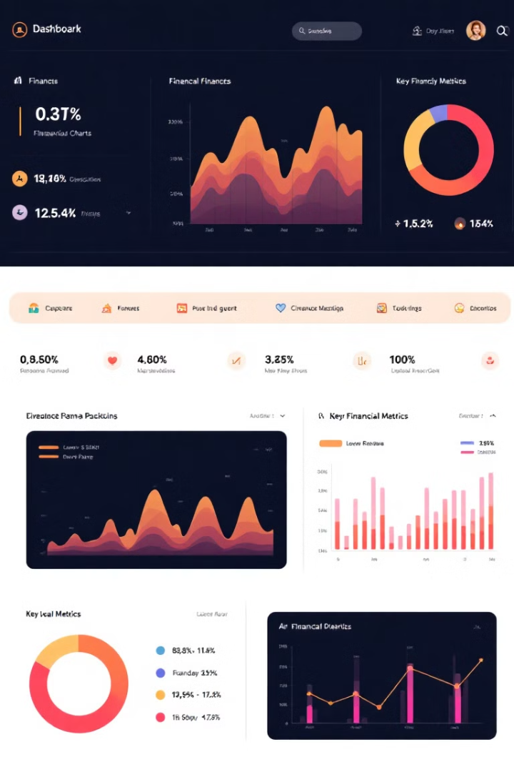
Expense Tracker: Your Personal Financial Assistant
Introducing the Expense Tracker app - your personalized financial companion that empowers you to take control of your spending, achieve your savings goals, and gain valuable insights into your money management. Dive into the powerful features that make this app an indispensable tool for your financial well-being.
Notes:
The Expense Tracker is a comprehensive app designed to simplify personal finance management. It provides real-time updates, syncing expense data instantly to ensure accuracy. Users receive notifications when approaching budget limits or encountering unusual spending patterns, promoting better financial awareness. The app also offers a historical view of expenses, helping users track trends and identify areas for improvement. With its user-friendly features, the Expense Tracker empowers individuals to take charge of their finances and achieve their savings goals.

Slide 9

Real-time Expense Tracking
Instant Updates
Historical View
Expense Tracker automatically syncs your data, ensuring you always have the most up-to-date information.
Review your expense history and track your progress over time to identify trends and opportunities for savings.
1
2
3
Notifications
Get alerted when you're approaching your budget limits or when unusual expenses occur.

Slide 10
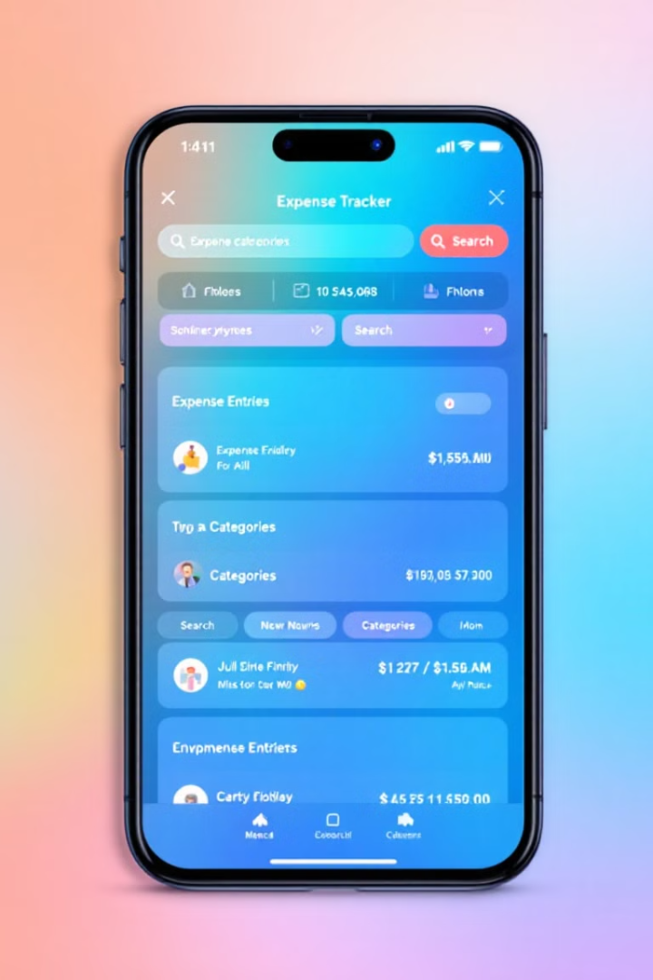
Logging Expenses: Record, Categorize, and Manage
Effortless Tracking
Comprehensive Categorization
Quickly log your daily expenses with intuitive categorization and seamless mobile integration.
Assign your expenses to intuitive categories for better organization and analysis.
Real-time Management
View, edit, and delete your expense records to maintain a clean and accurate financial history.
Notes:
The Expense Tracker simplifies expense management with features designed for ease of use. Users can quickly log daily expenses and assign them to intuitive categories for better organization and tracking. Real-time management tools allow users to edit or delete records as needed, ensuring a clean and accurate financial history. With its intuitive interface and seamless integration, the Expense Tracker provides a practical solution for maintaining control over personal finances and fostering better money habits.

Slide 11

"The secret of getting ahead is getting started." - Mark Twain

